Slide 1
FUSIONNENT：Fusing via Fully-aware Attention with Application to Machine Comprehension
ICLR 2018 under review
盛艺暄
12月13日

Slide 2
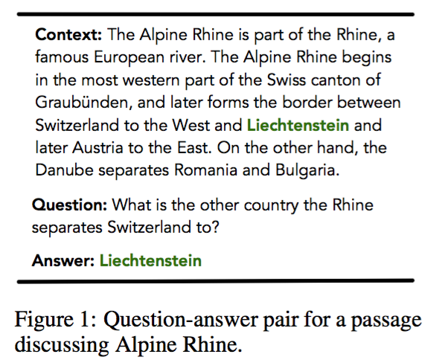
Dataset：SQuAD

Slide 3
First, it puts forward a novel concept of “history of word” to characterize attention information from the lowest word-level embedding up to the highest semantic-level representation.
Second, it introduces an improved attention scoring function that better utilizes the “history of word” concept.
Third, it proposes a fully-aware multi-level attention mechanism to capture the complete information in one text (such as a question) and exploit it in its counterpart (such as context or passage) layer by layer.

Slide 4
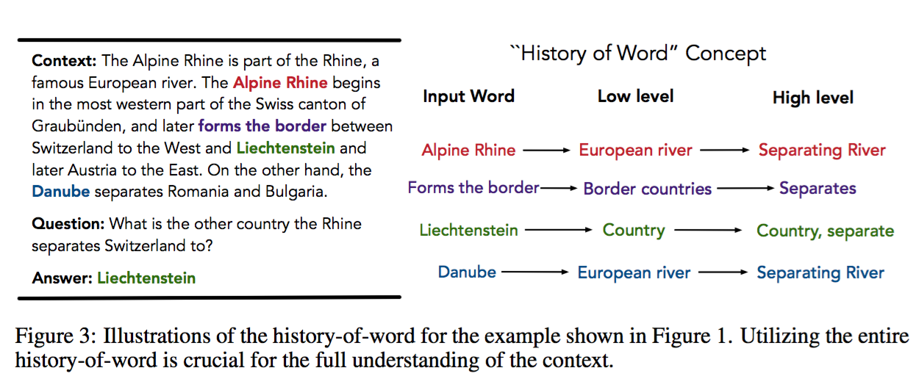
“History of word”Concept
Define history of the i-th word, HoWi, to be the concatenation of all the representations generated for this word.

Slide 5
Fully-aware Attention
Given text A and B:
two sets of hidden vectors for words in text bodies A and B:
Their associated history-of-word are

Slide 6
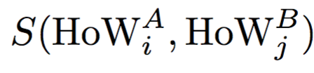
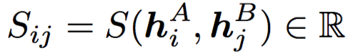
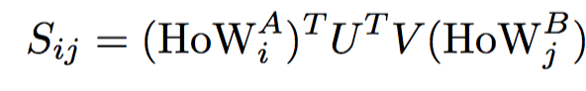
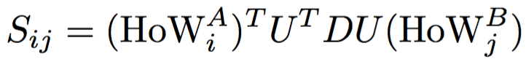
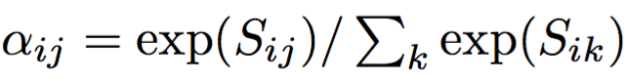
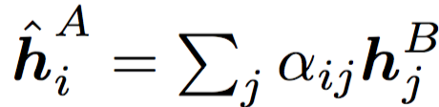
standard attention
Fully-aware Attention
f(x)=max(0,x)

Slide 7
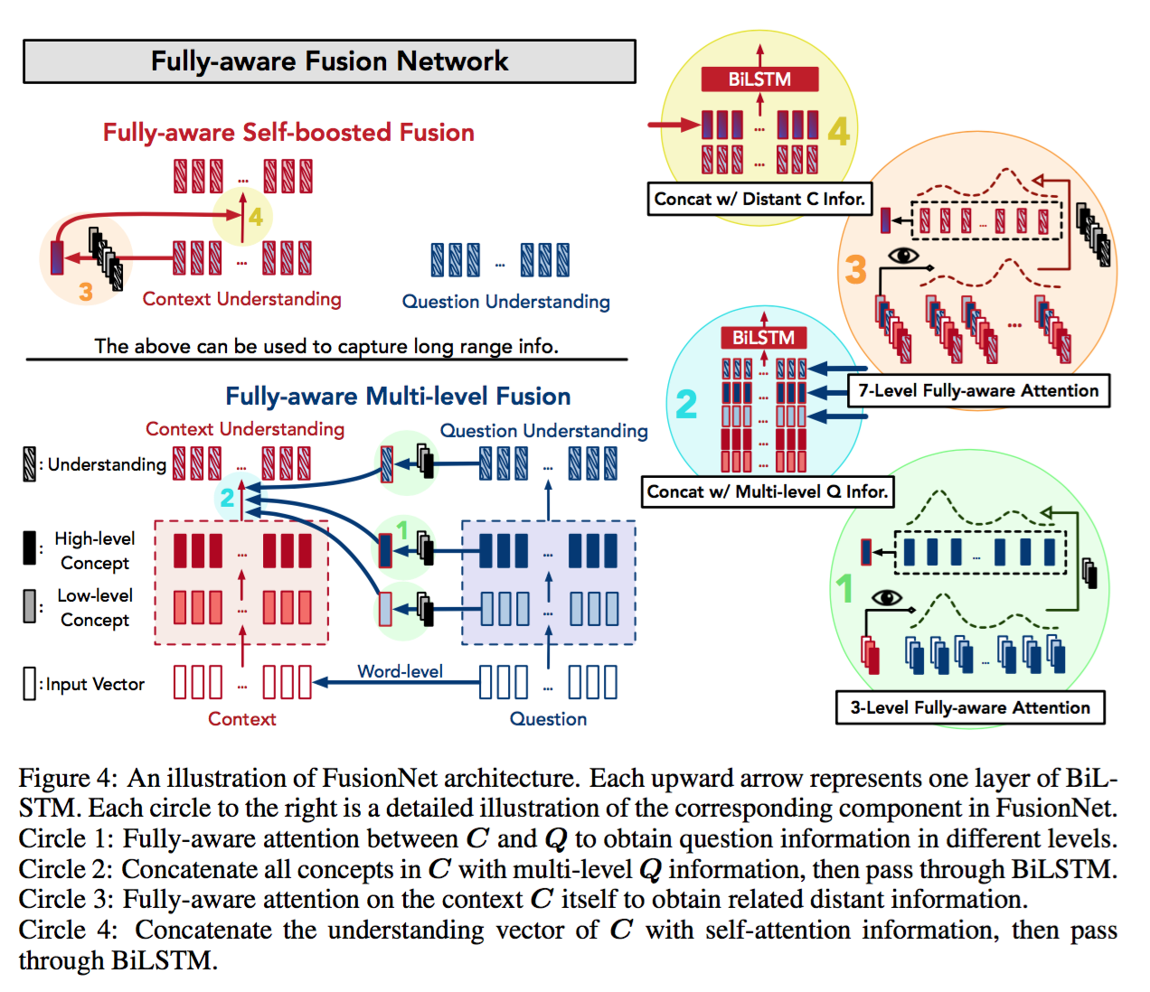

Slide 8
Fully-aware Fusion Network
where text A is context C and text B is question Q
Input vectors:
300-dim GloVe ,
600-dim contextualized vector (McCann et al., 2017)
12-dim POS embedding,
8-dim NER embedding,
and a normalized term frequency for context C as suggested in (Chen et al., 2017)

Slide 9
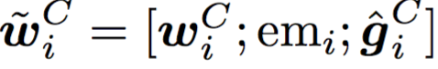
Fully-aware Multi-level Fusion: Word-level.
① a feature vector emi is created for each word in C to indicate
whether the word occurs in the question Q.
② attention-based fusion on GloVe embedding gi is used
enhanced input vector for context ：

Slide 10
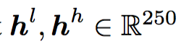
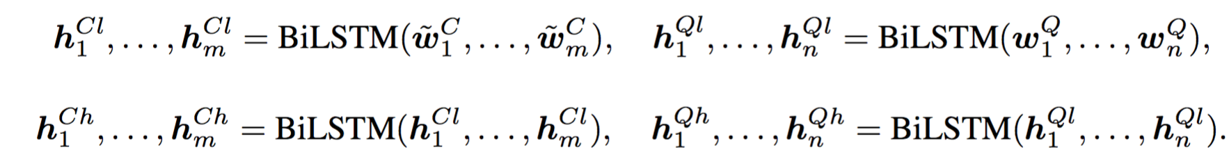
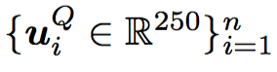
Reading component：
Separate BiLSTM
are created for each word
Question Understanding ：
final question representation UQ ：

Slide 11
Fully-aware Multi-level Fusion: Higher-level.
① identify the common history-of-word for both C , Q
gi is the GloVe embedding ， ci is the CoVe embedding

Slide 12
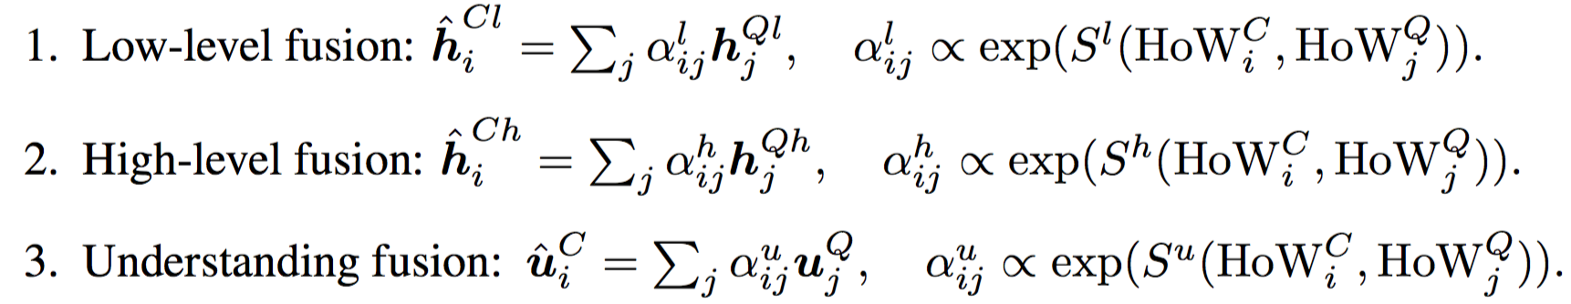
② fuse low, high, and understanding-level information from Q to C
via fully-aware attention.
obtain the representation for C fully fused with information in the Q ：

Slide 13
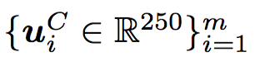
Fully-aware Self-boosted Fusion.
① identify the history-of-word to be：
②
final context representation （understanding vectors for C)

Slide 14
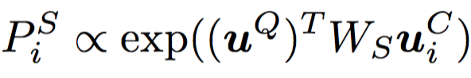
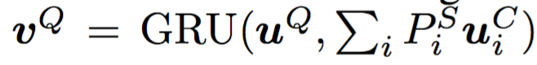
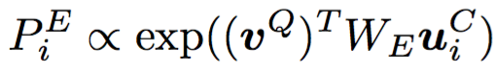
Predict Answer：
understanding vectors for both C and Q：
①
②

Slide 15
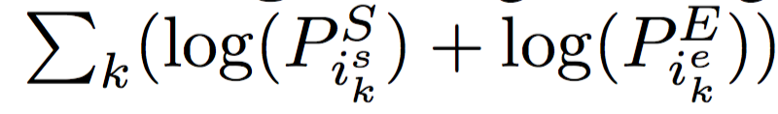
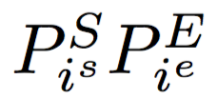
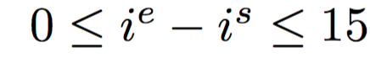
Training.
maximize
Prediction.
maximum
under the constraint

Slide 16
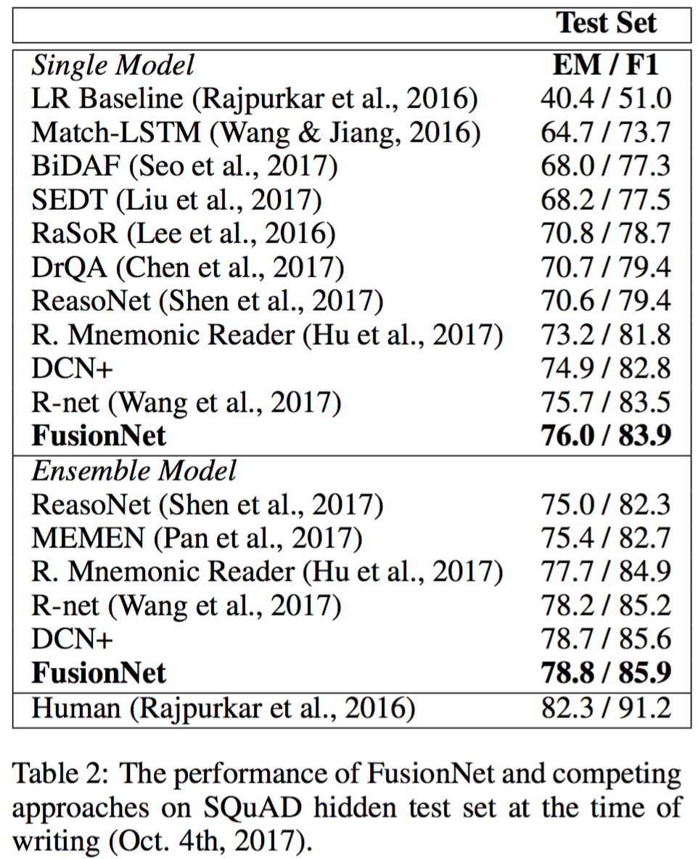
Result:

Slide 17
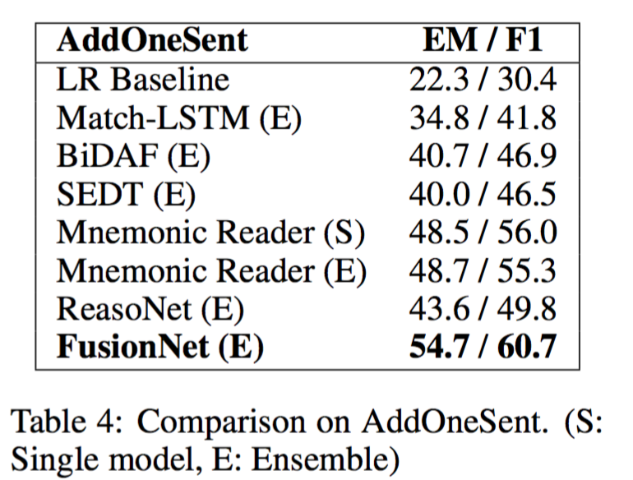
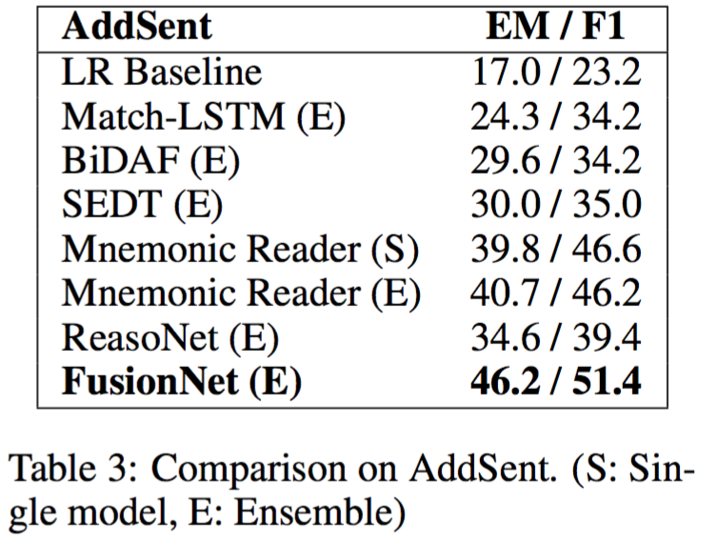
Result:

Slide 18
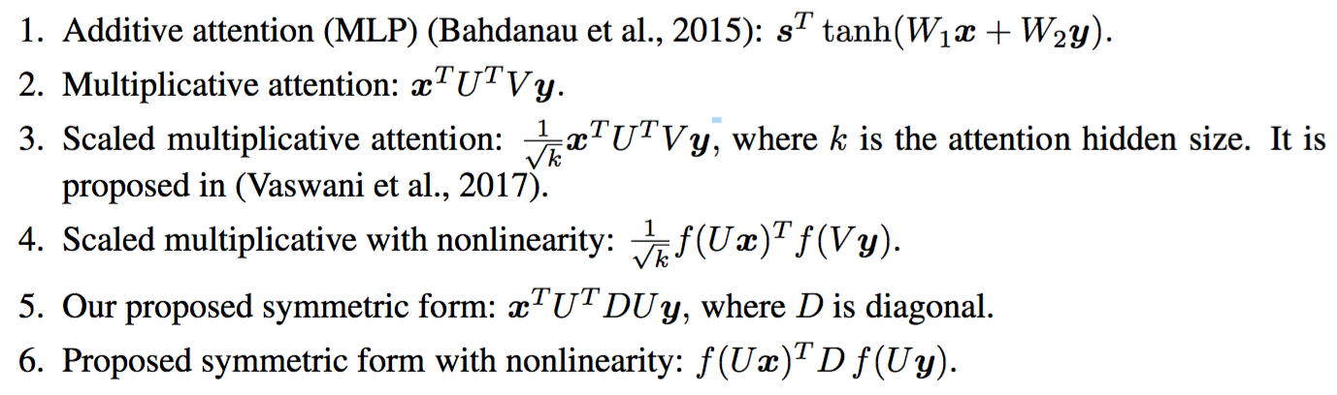
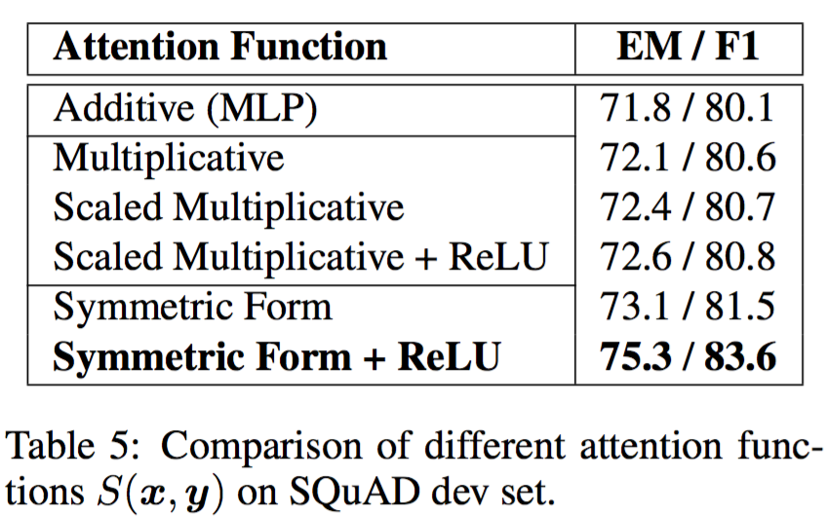
Comparison on Attention Function:

Slide 19
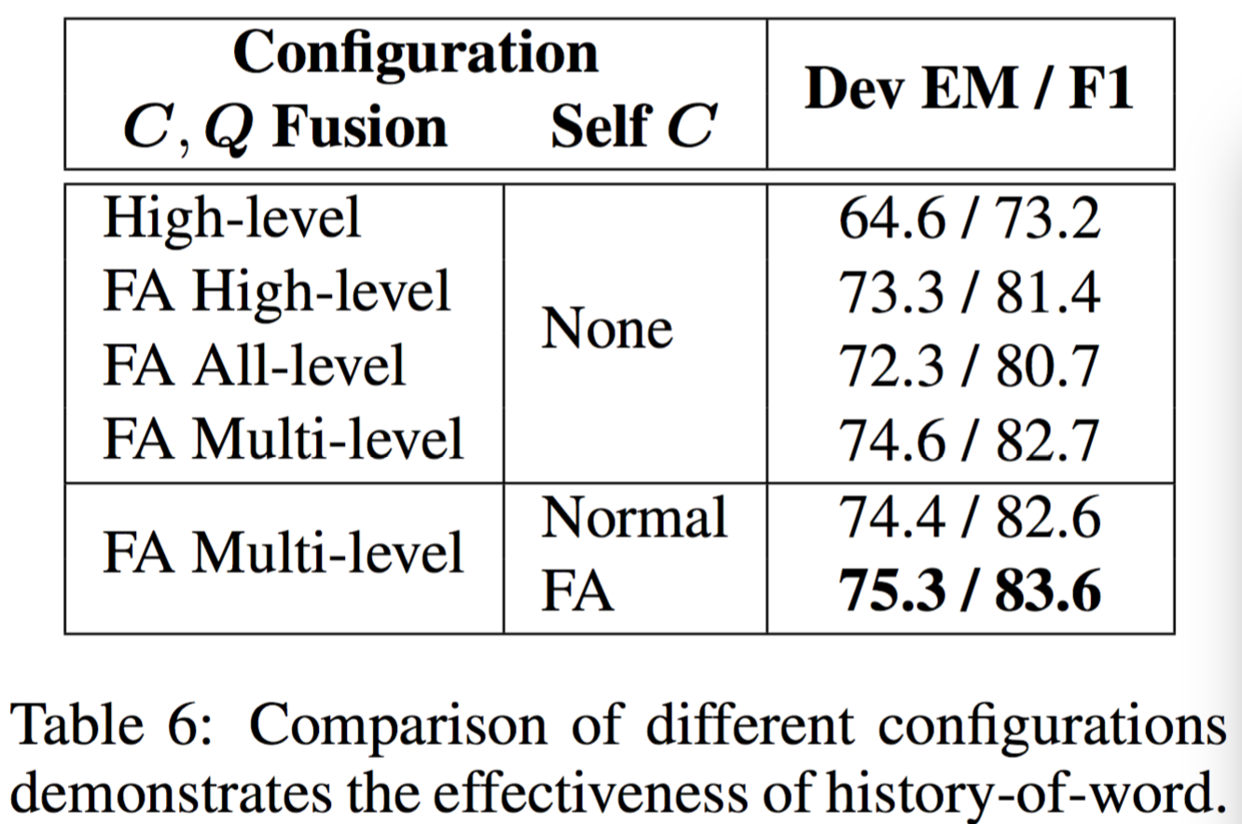
Result:

Slide 20
Thanks!

